Slide 1
Literature Review and Taxonomy on Reallocation Strategies for Bike-Sharing Platforms
Scientific Project Applications of Artificial Intelligence
Faculty of Economics and Management Jun. Prof. Kai Heinrich
Md. Ali Azzan Esha Zahed Hossain Fahim Willem Franz Weiss
5. October 2023

Slide 2
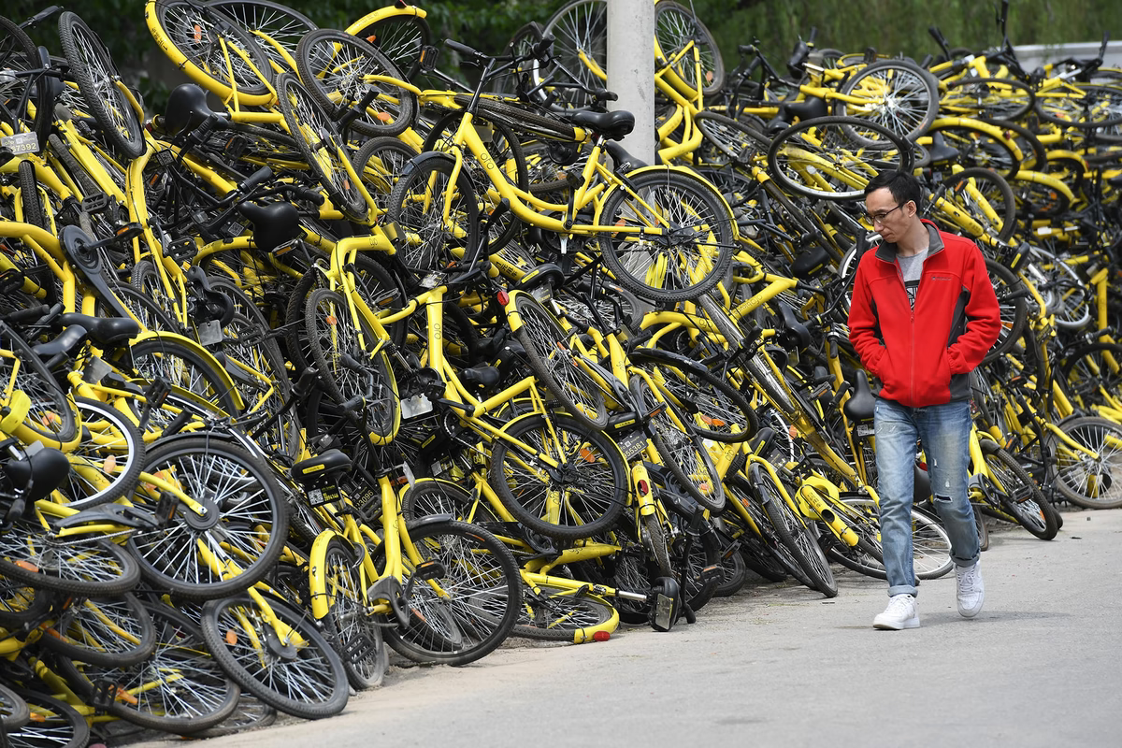
How could we avoid this?
https://asiatimes.com/2019/09/recyclers-face-mountains-of-abandoned-bikes/

Slide 3
Agenda
Introduction
Methodology & Systematic Overview
Taxonomy & Summary of Results
Problems
Data Scenarios
Optimization Method
Conclusion

Slide 4
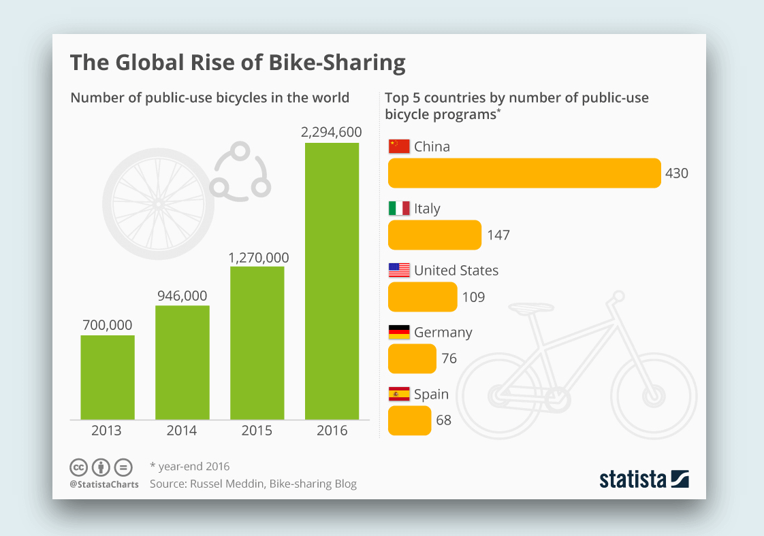
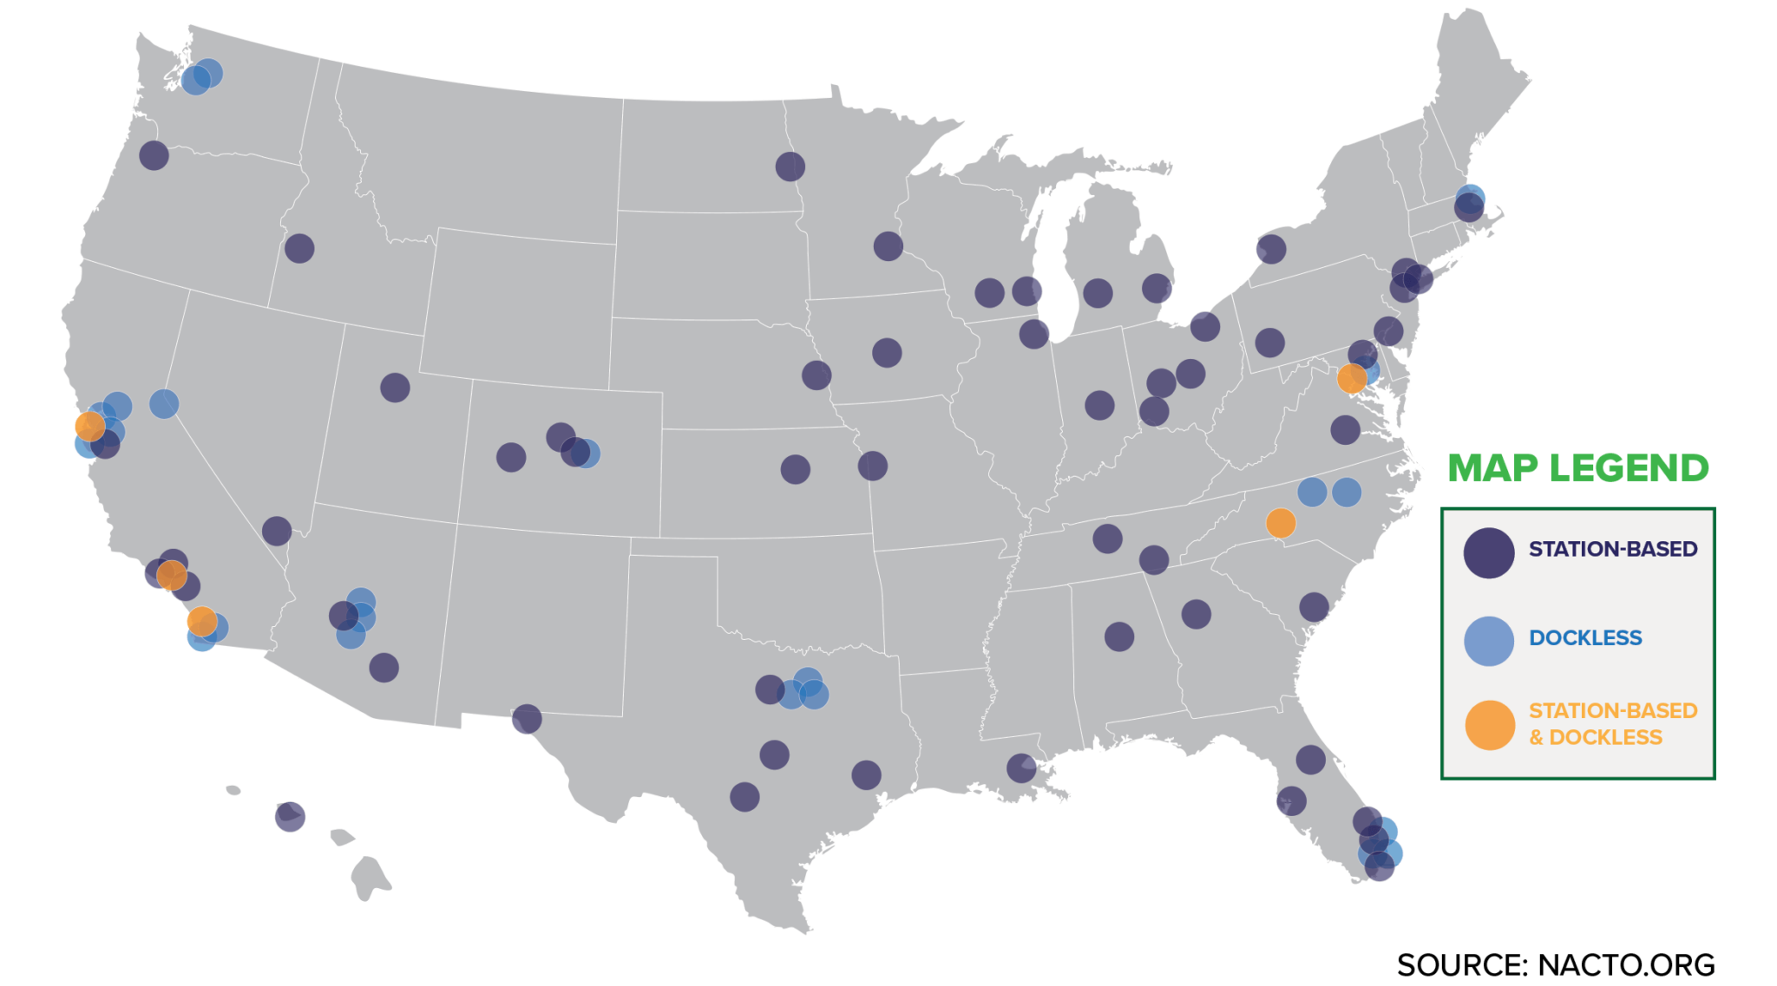
Introduction
https://www.spaceotechnologies.com/blog/top-bike-sharing-app-benefits/
Notes:
Bike-sharing systems worldwide
Station based and dockless categories
Rent and return option

Slide 5
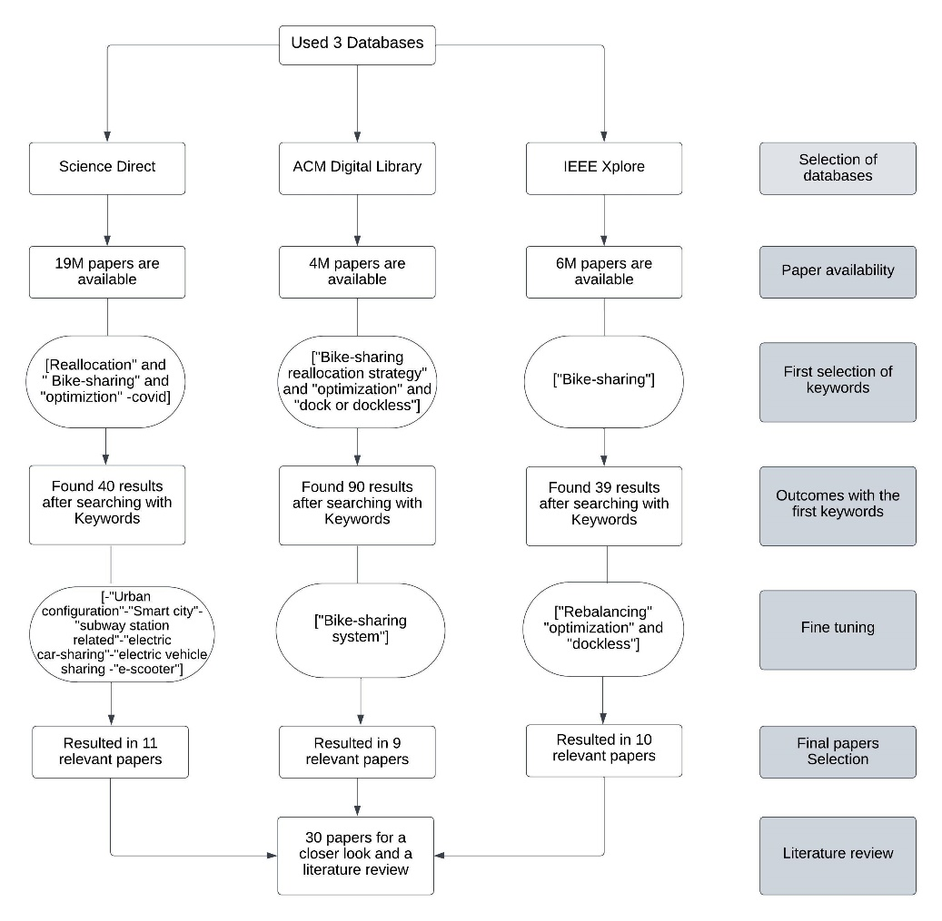
Methodology & Systematic Overview

Slide 6
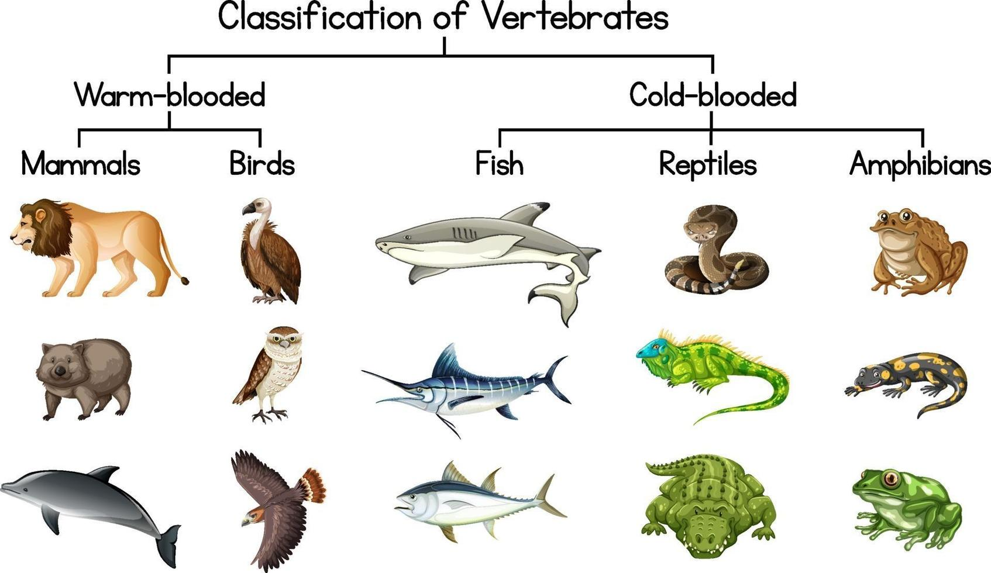
Taxonomy
https://facts.net/wp-content/uploads/2023/09/14-unbelievable-facts-about-vertebrate-taxonomy-1693788452.jpg
Notes:
What is a Taxonomy? – Classification: Known from Biology → Find connecting criteria to sort ito classes

Slide 7
Our Taxonomy
Notes:
Main classifications: Problem Types and Optimization Types
Problems!
17 x Imbalance of Supply and Demand !central
15 x Traffic Pattern
8x Operational Inefficiencies
Optimization Types!
9x Mixed and Linear Integer Programming
6x Clustering
4x Neural Networks
→ In the following slides we will discuss the important characteristics…

Slide 8

Problem Types
https://www.nowwhat-architexx.org/

Slide 9
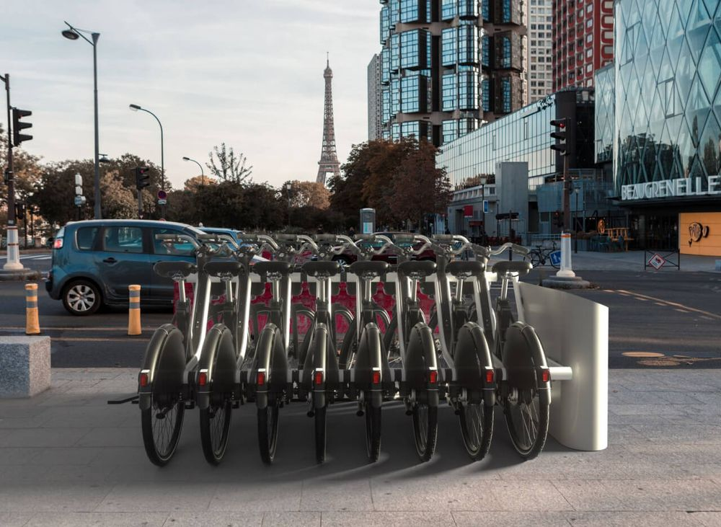
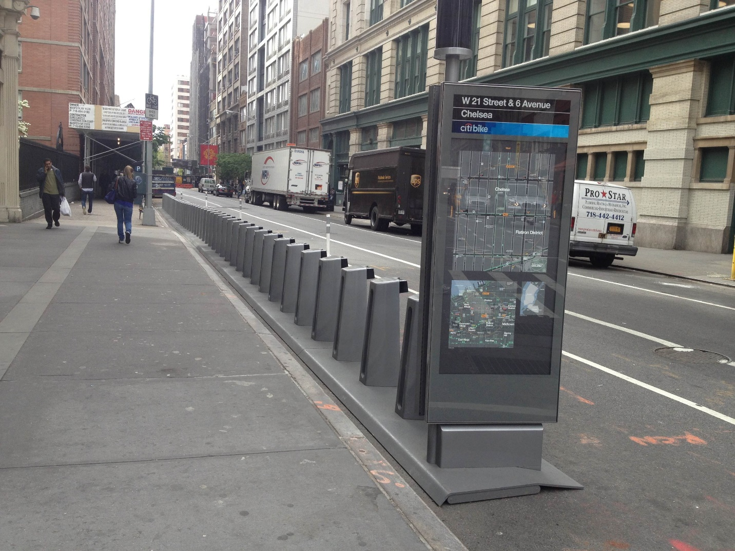
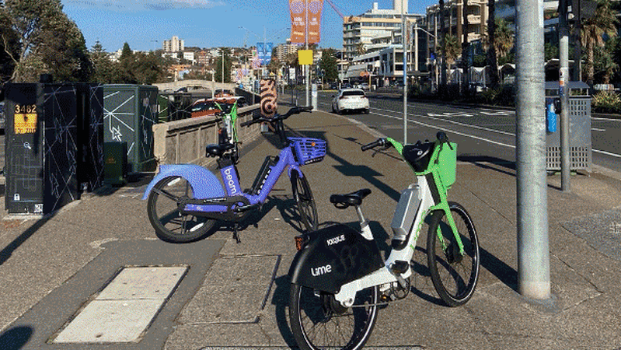
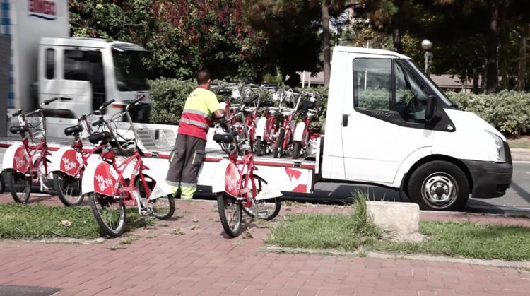
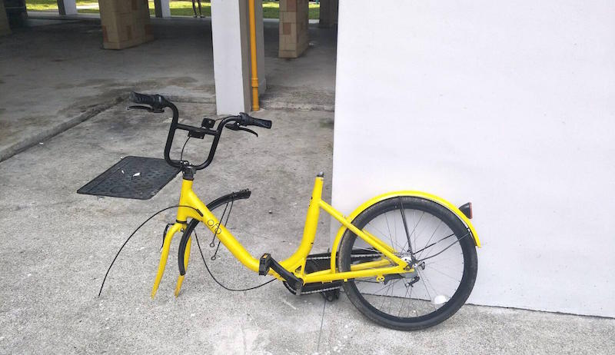

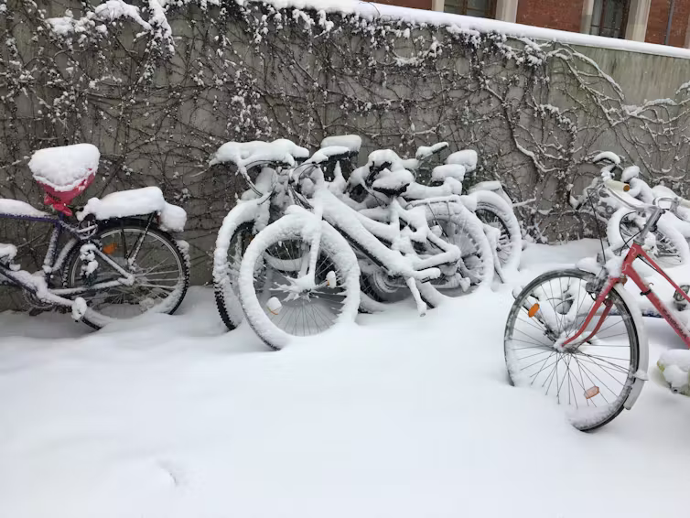
https://blogs.baruch.cuny.edu/lifeontwowheels/files/2013/05/citibike_empty.jpg
https://storage.googleapis.com/fifteen-strapi-assets/large_station_fifteen_faite_pour_durer_d747e7e8e5/large_station_fifteen_faite_pour_durer_d747e7e8e5.jpg
https://www.smh.com.au/national/nsw/thousands-of-share-bikes-are-back-in-sydney-will-they-clog-the-streets-again-20230726-p5drj8.html
!
https://ecf.com/news-and-events/news/smarter-cycling-series-data-bike-share-bike-share
https://coconuts.co/singapore/news/in-pics-all-the-weird-ways-singaporeans-have-mistreated-damaged-shared-bicycles/
https://www.bostonglobe.com/metro/2018/07/13/dockless-bikes-keep-ending-underwater/0fymQ6I4BDjx3AXwti0knM/story.html
https://theconversation.com/we-analysed-100-million-bike-trips-to-reveal-where-in-the-world-cyclists-are-most-likely-to-brave-rain-and-cold-166894
Notes:
Important:
imbalance of Supply and Demand !central → basic economy: bike overflow or underflow (docked and dockeless)
unbalanced spatial distribution and low utilization rate: Important: capacity of points of interests (POIs) as well as areas of interests (AOIs)
Weather
Road blockage
Broken or destroyed bikes
Other noteable problems: Social fairness – poorer areas…; Bike reallocation with cars

Slide 10

Data Scenarios
https://www.ionixxtech.com/resources/whitepaper-ebooks/data-aggregation-platform-development

Slide 11
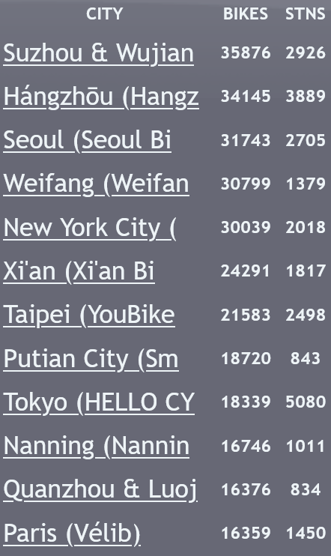
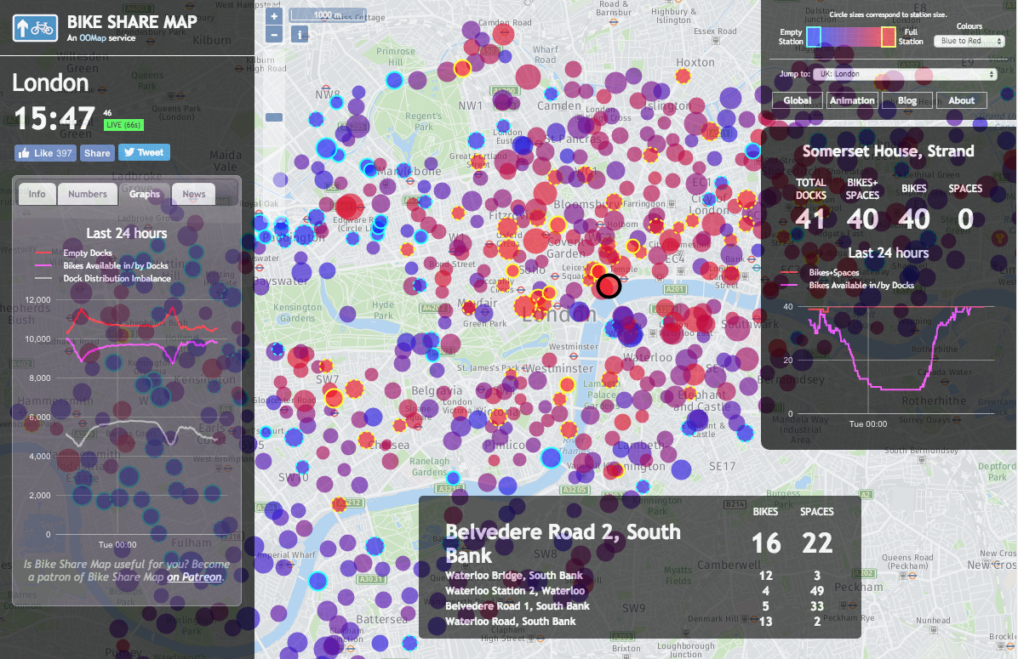
Aggregated real-time data
bikesharemap.com
Notes:
Worldwide are BSS installed: Data is easily available – Notable: China! ~Suzhou & Wujian; Hangzou 35000 Bikes; Seoul; NY; Tokyo; Paris

Slide 12
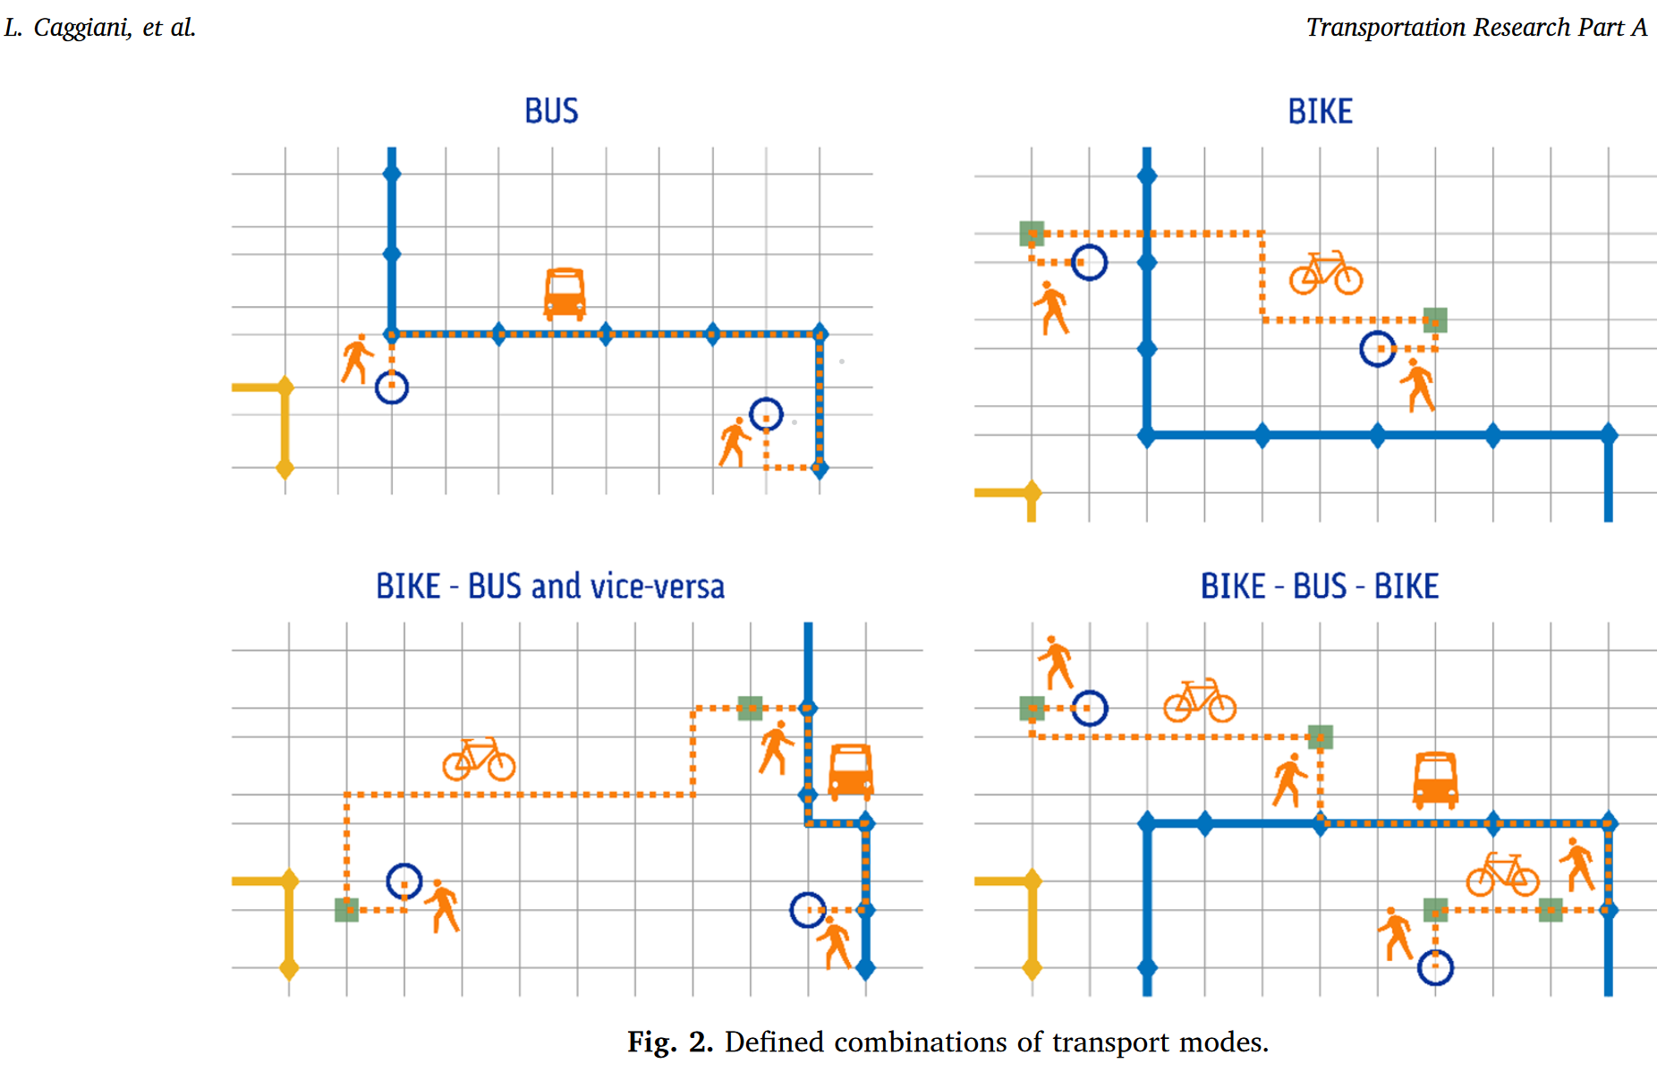
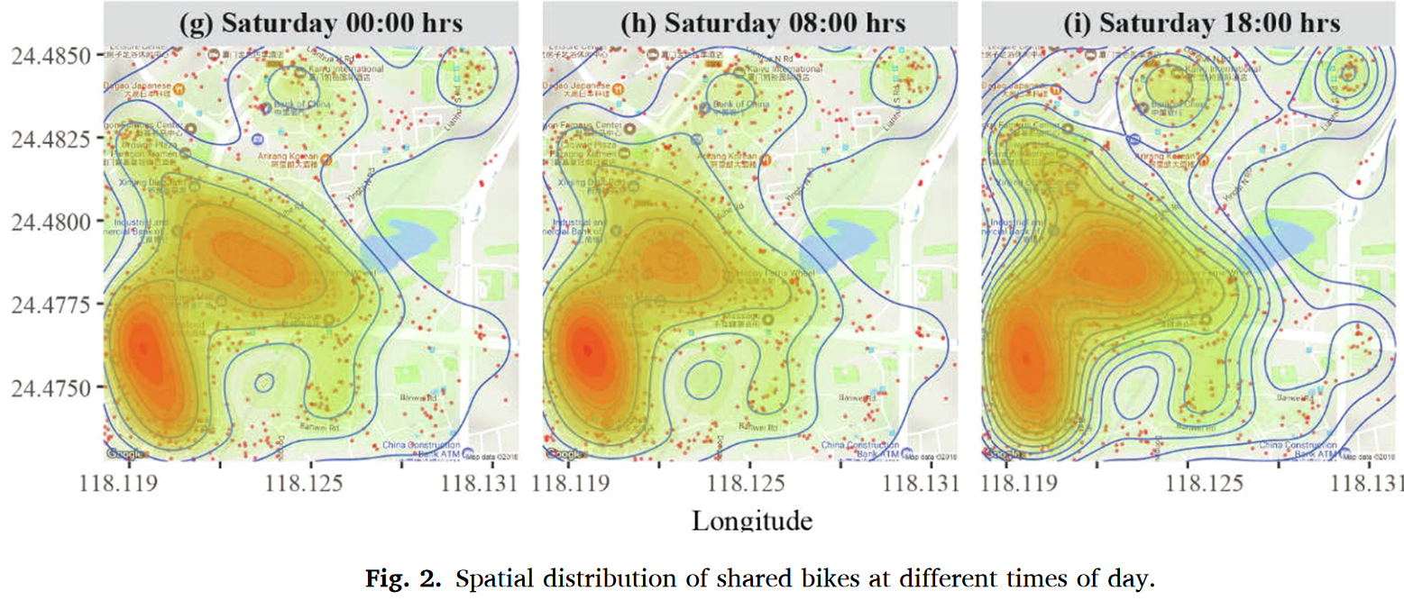
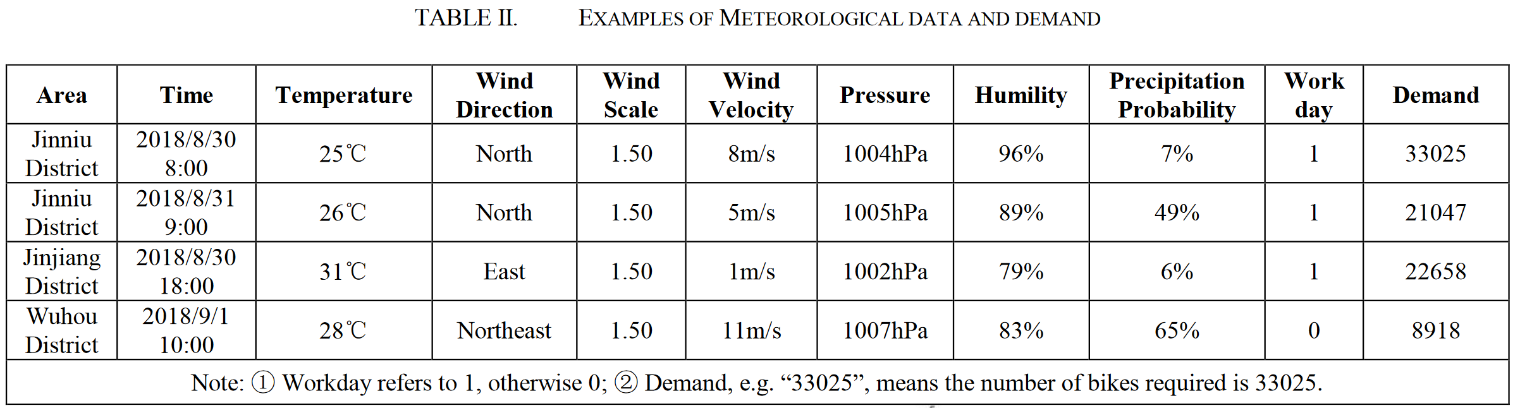
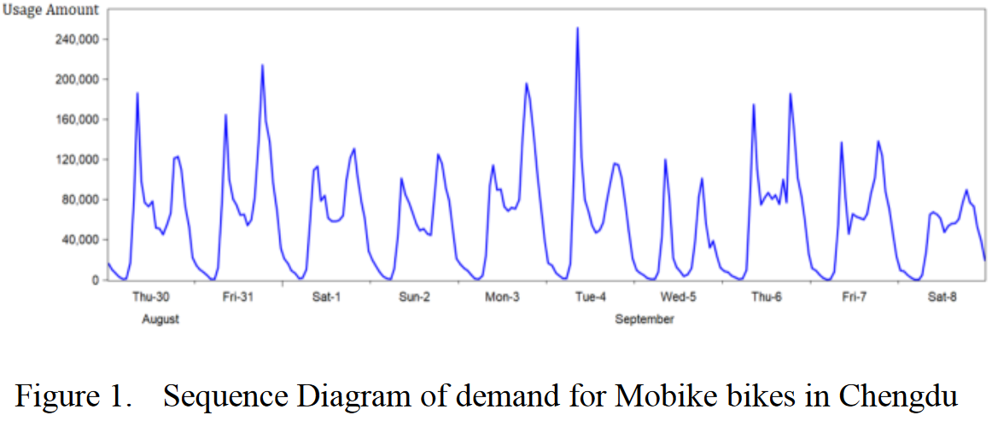
Simulated data
Spatial data
Weather data
Notes:
Bike-sharing station location – Authors used a simulation with 693 nodes and 2616 arcs- system on a 3km x 3,6km grid – 200 possible bike stations + limitations → optimal distribution and route finding
Spatial „Density“ data

Slide 13

Optimization Approaches

Slide 14
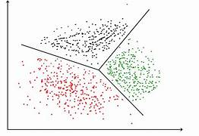
Clustering Algorithms
Geographical Clustering
Pattern-based Clustering
Density-Based Spatial Clustering

Slide 15
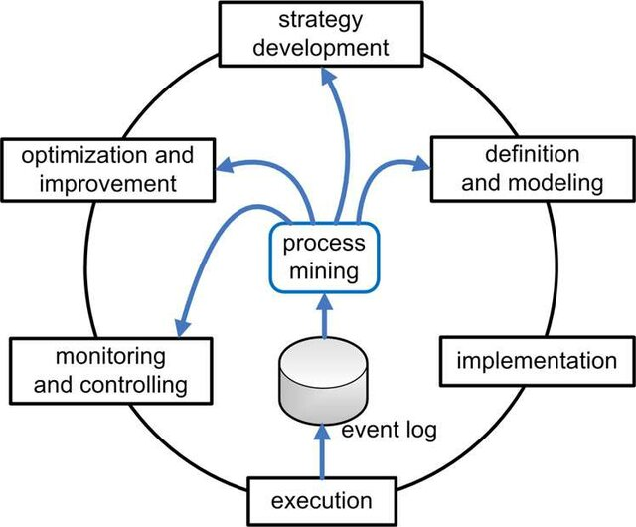
Ordinary Least Squares (OLS)
Regression Model
Process Mining Technique

Slide 16

Neural Networks
Dynamic Convolutional Neural Network
Acquisition layer
Data processing layer
DCNN layer
Data Visualization layer

Slide 17

Gradient-Boosted Regression Trees
Regression Tree
Gradient Descent Optimization

Slide 18

Conclusion
Studied 30 research papers
Solved the problem by using optimization approaches
Used real-time, simulated, weather, and spatial data

Slide 19


QUESTION SESSION

